Slide 1
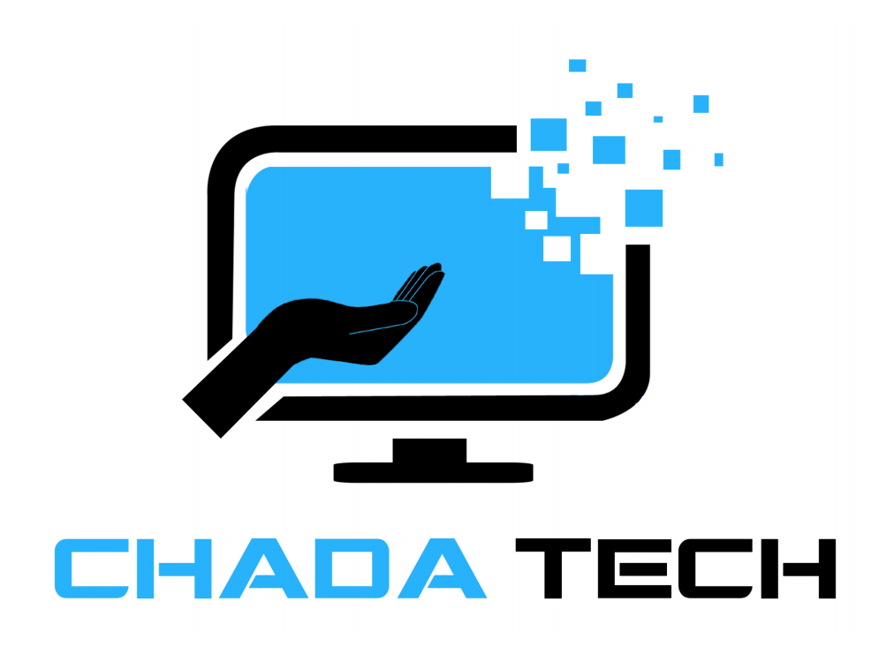
Agile & WaterFall Development
Final Project
Drina Baptiste
CS 250

Slide 2
Agile Roles
Scrum Master: Facilitates team scrum events and ensures smooth communication.
Product Owner: Defines the product vision and prioritizes features.
Tester: Responsible for identifying bugs and issues in the product by conducting various testing activities. Testers ensure the product meets the required quality standards before release.
Developer: Focuses on writing and maintaining code to build the product's features. Developers collaborate with other team members to ensure the functionality is delivered in line with project requirements.

Slide 3
The Agile Phases
1. Concept: Stakeholders and product owners work together to establish the project’s goals and scope at the start of the agile cycle.
2. Inception: The founder assigns positions, chooses the right team members, and provides development with the resource it needs throughout this stage
3. Iteration: All business needs and feedback are implemented into the code. An MVP is typically done, with more functionality to be added later.
4. Testing: After the first iteration of the software and development. The application foes through a quality assurance review.
5. Production: The application is recalled to a server or cloud when ready for public release. Or the product is live and is available to the clients.
6. Review: Clients typically offer suggestions for features, or provide feedback.

Slide 4

The Waterfall Model
Waterfall is a linear, sequential approach. The phases are requirements, design, implementation, verification, and maintenance. Changes are harder to implement after phases are completed. Testing comes after the development phase, so problems are identified later in the cycle. You must finish one phase before beginning the next.

Slide 5
Waterfall or Agile Approach?
Factors to consider:
Project Scope: Agile is better for dynamic, evolving projects. Waterfall is suited for fixed requirements.
Client Involvement: Agile requires continuous client feedback. Waterfall involves the client primarily in the beginning.
Risk Management: Agile allows earlier risk identification due to its iterative nature.
Time-to-Market: Agile delivers faster increments, while Waterfall delivers after the full cycle.

Slide 6
References
Atlassian. “Waterfall Methodology for Project Management.” Atlassian, www.atlassian.com/agile/project-management/waterfall-methodology. Accessed 19 Oct. 2024.
“Stages of the Agile SDLC (Software Development Lifecycle).” GeeksforGeeks, GeeksforGeeks, 31 July 2024, www.geeksforgeeks.org/stages-of-the-agile-sdlc-software-development-lifecycle/.
“Agile vs Waterfall Project Management.” GeeksforGeeks, GeeksforGeeks, 25 June 2024, www.geeksforgeeks.org/agile-vs-waterfall/.

